Slide 1

“Fitness Tracker and Goal Setter”
Sanjivani Rural Education Society’s
Sanjivani College of Engineering, Kopargaon 423 603
(Affiliated to Savitribai Phule Pune University, Pune )
Department of Computer Engineering
Prepared By
Miss. Bhakti Shinde[UCS23F1115]
Guided By,
Prof. S. S. Gawali

Slide 2
Contents
Sanjivani Rural Education Society’s
Sanjivani College of Engineering, Kopargaon 423 603
(Affiliated to Savitribai Phule Pune University, Pune )
Department of Computer Engineering Research Center
Introduction of project
Functionality of project
Details about Data types used in project
Details about predefine module/libraries used in project
Details about predefined function.
Output of Code.

Slide 3
Introduction
Sanjivani Rural Education Society’s
Sanjivani College of Engineering, Kopargaon 423 603
(Affiliated to Savitribai Phule Pune University, Pune )
In today's health-conscious era, establishing a robust online presence for fitness-oriented local businesses is paramount.
Our platform serves as the conduit between traditional fitness centers and the expansive digital fitness community, empowering local fitness establishments to flourish in the digital realm.In today's digital age, the need for local businesses to establish a strong online presence is more crucial than ever.
Objectives
Our core mission revolves around championing and amplifying local fitness enterprises by providing them with a dedicated online platform to expand their reach and impact
Our objective is to curate a frictionless fitness journey for consumers, enabling them to explore and acquire products and services from nearby fitness establishments effortlessly.

Slide 4
Functionality of Project
Sanjivani Rural Education Society’s
Sanjivani College of Engineering, Kopargaon 423 603
(Affiliated to Savitribai Phule Pune University, Pune )
User Registration Window: Users can register with their UserID, Name, Age, Gender, Height, Weight, and Email. Once the user fills out the registration form and submits it, a success message is displayed, and the registration window is closed.
BMI Calculator Window: Users can calculate their Body Mass Index (BMI) by entering their height in meters and weight in kilograms. After clicking the "Calculate BMI" button, the BMI value is displayed along with a BMI category (Normal, Underweight, Overweight). If the BMI indicates underweight or overweight, a Weight Management window is opened.
Weight Management Window: Depending on the BMI category (underweight or overweight), this window provides options for weight gain or weight loss plans, respectively. Each plan includes input fields for setting daily goals related to steps, calories, active minutes, water intake, and sleep duration. Users can calculate progress, clear entered data, set goals, or set default goals.
Progress Calculation: After entering data in the weight management window, users can calculate their progress. The application calculates progress percentages for steps, calories, active minutes, water intake, and sleep duration goals. Based on the progress, motivational messages are displayed.
Default Goals: Users can set default goals for steps, calories, active minutes, water intake, and sleep duration by clicking the "Set Default Goals" button. This fills the input fields with default values.
Clear Data: Users can clear all entered data in the weight management window by clicking the "Clear Data" button.
Motivational Messages: Depending on the progress percentage, motivational messages are displayed to encourage users to achieve their fitness goals.

Slide 5
Details about Data types used in project
Sanjivani Rural Education Society’s
Sanjivani College of Engineering, Kopargaon 423 603
(Affiliated to Savitribai Phule Pune University, Pune )
Integer (int): Used for storing numerical values like steps goal, calories goal, active minutes goal, etc. Integers: Used for age.
Float (float): Used for storing decimal values, particularly in calculations like BMI calculation. For Lists: Used for workout_schedule.
String (str): Used for storing textual data like user IDs, names, email addresses, etc.
Boolean (bool): Though not explicitly mentioned in the provided code, boolean values can be used for conditions or flags.
List (list): Lists can be used to store collections of values, but they are not explicitly used in this code. They could be useful for organizing data in more complex applications.
Tuple (tuple): Similar to lists, tuples can be used to store collections of values. However, they are immutable, meaning their values cannot be changed after creation.
Dictionary (dict): Dictionaries can be useful for storing key-value pairs, such as user data where each user ID maps to a set of attributes.

Slide 6
Details about predefine module/libraries used in project
Sanjivani Rural Education Society’s
Sanjivani College of Engineering, Kopargaon 423 603
(Affiliated to Savitribai Phule Pune University, Pune )
tkinter (import tkinter as tk): This is the main module for creating GUI applications in Python. It provides a framework to create windows, widgets, and handle events.
messagebox (from tkinter import messagebox): This module is a part of the tkinter library and provides functions to display message boxes for showing information, warning, error messages, etc.

Slide 7
Details about predefined function
Sanjivani Rural Education Society’s
Sanjivani College of Engineering, Kopargaon 423 603
(Affiliated to Savitribai Phule Pune University, Pune )
_init_(self, root): Initializes the FitnessApp class.
save_profile(self): Saves user profile data entered in the GUI.
track_progress(self): Tracks user's fitness progress and displays a summary.
recommend_workouts(self, fitness_level): Recommends workouts based on fitness level.
set_fitness_goal(self): Sets the user's fitness goal.
calculate_bmi(weight_kg, height_m): Calculates BMI.
determine_fitness_level(bmi, age): Determines fitness level based on BMI and age. tk.Toplevel(root): This function creates a new window (or toplevel window) that is independent of the main/root window. It's typically used for creating dialog boxes or additional windows within an application.
tk.Label(): This function creates a text label widget that can display text or images. Labels are used to provide information or instructions to the user.
tk.Entry(): This function creates an entry widget, which allows the user to input a single line of text.
tk.Button(): This function creates a button widget that the user can click on to perform an action. The button can be configured with a command, which is a function that is called when the button is clicked.
tk.Messagebox.showinfo(): This function displays a message box with informational text. It's typically used to provide feedback or notifications to the user.
tk.Messagebox.showerror(): Similar to showinfo(), this function displays a message box with an error message.
tk.Entry.delete(): This method is used to delete characters from an entry widget. It takes the starting and ending indices of the characters to be deleted.

Slide 8
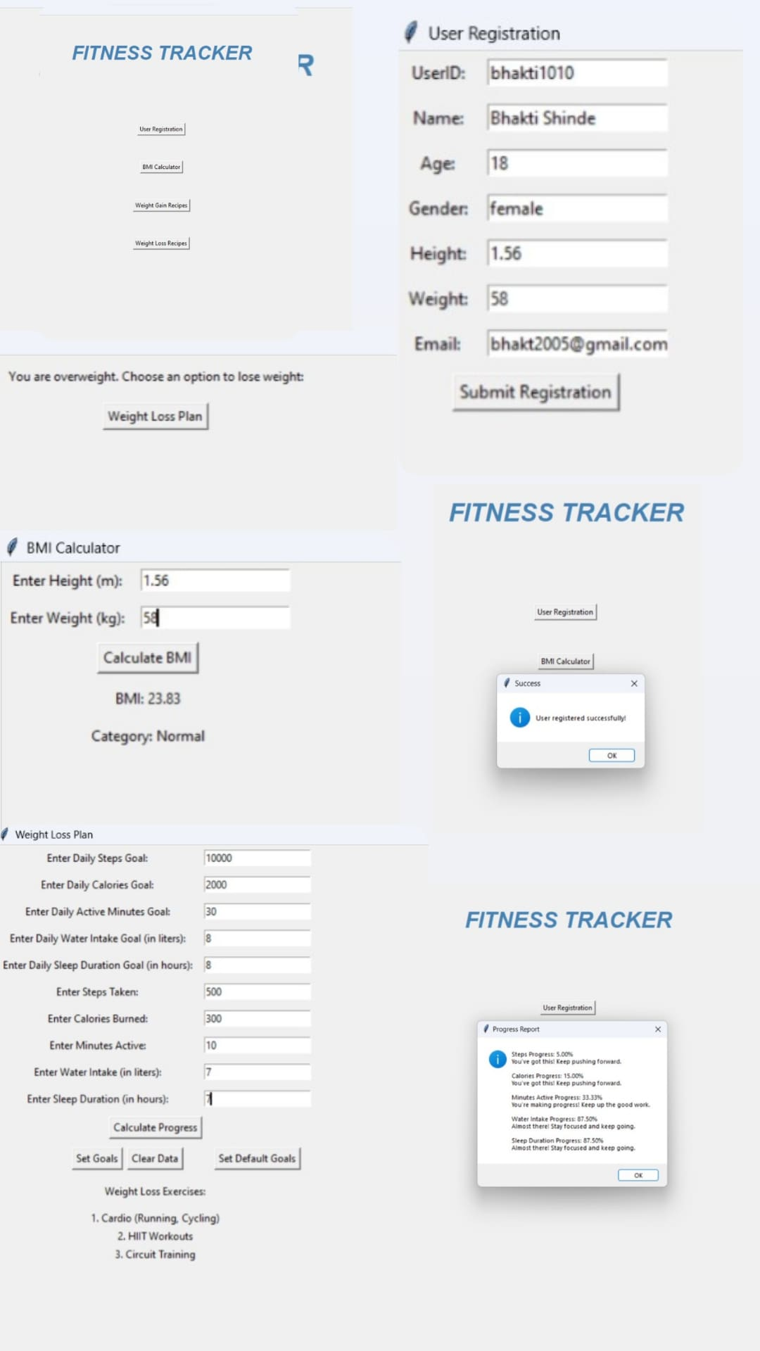
Output
Sanjivani Rural Education Society’s
Sanjivani College of Engineering, Kopargaon 423 603
(Affiliated to Savitribai Phule Pune University, Pune )

Slide 9
Thank You
Sanjivani Rural Education Society’s
Sanjivani College of Engineering, Kopargaon 423 603
(Affiliated to Savitribai Phule Pune University, Pune )

